Slide 1

Team 1
Cargo Connect:
Improving Airport Freight Flow
FNU Anuja
Smit Soneshbhai Patel
Bradley Evan Stover
Chijioke Elisha-Wigwe

Slide 2
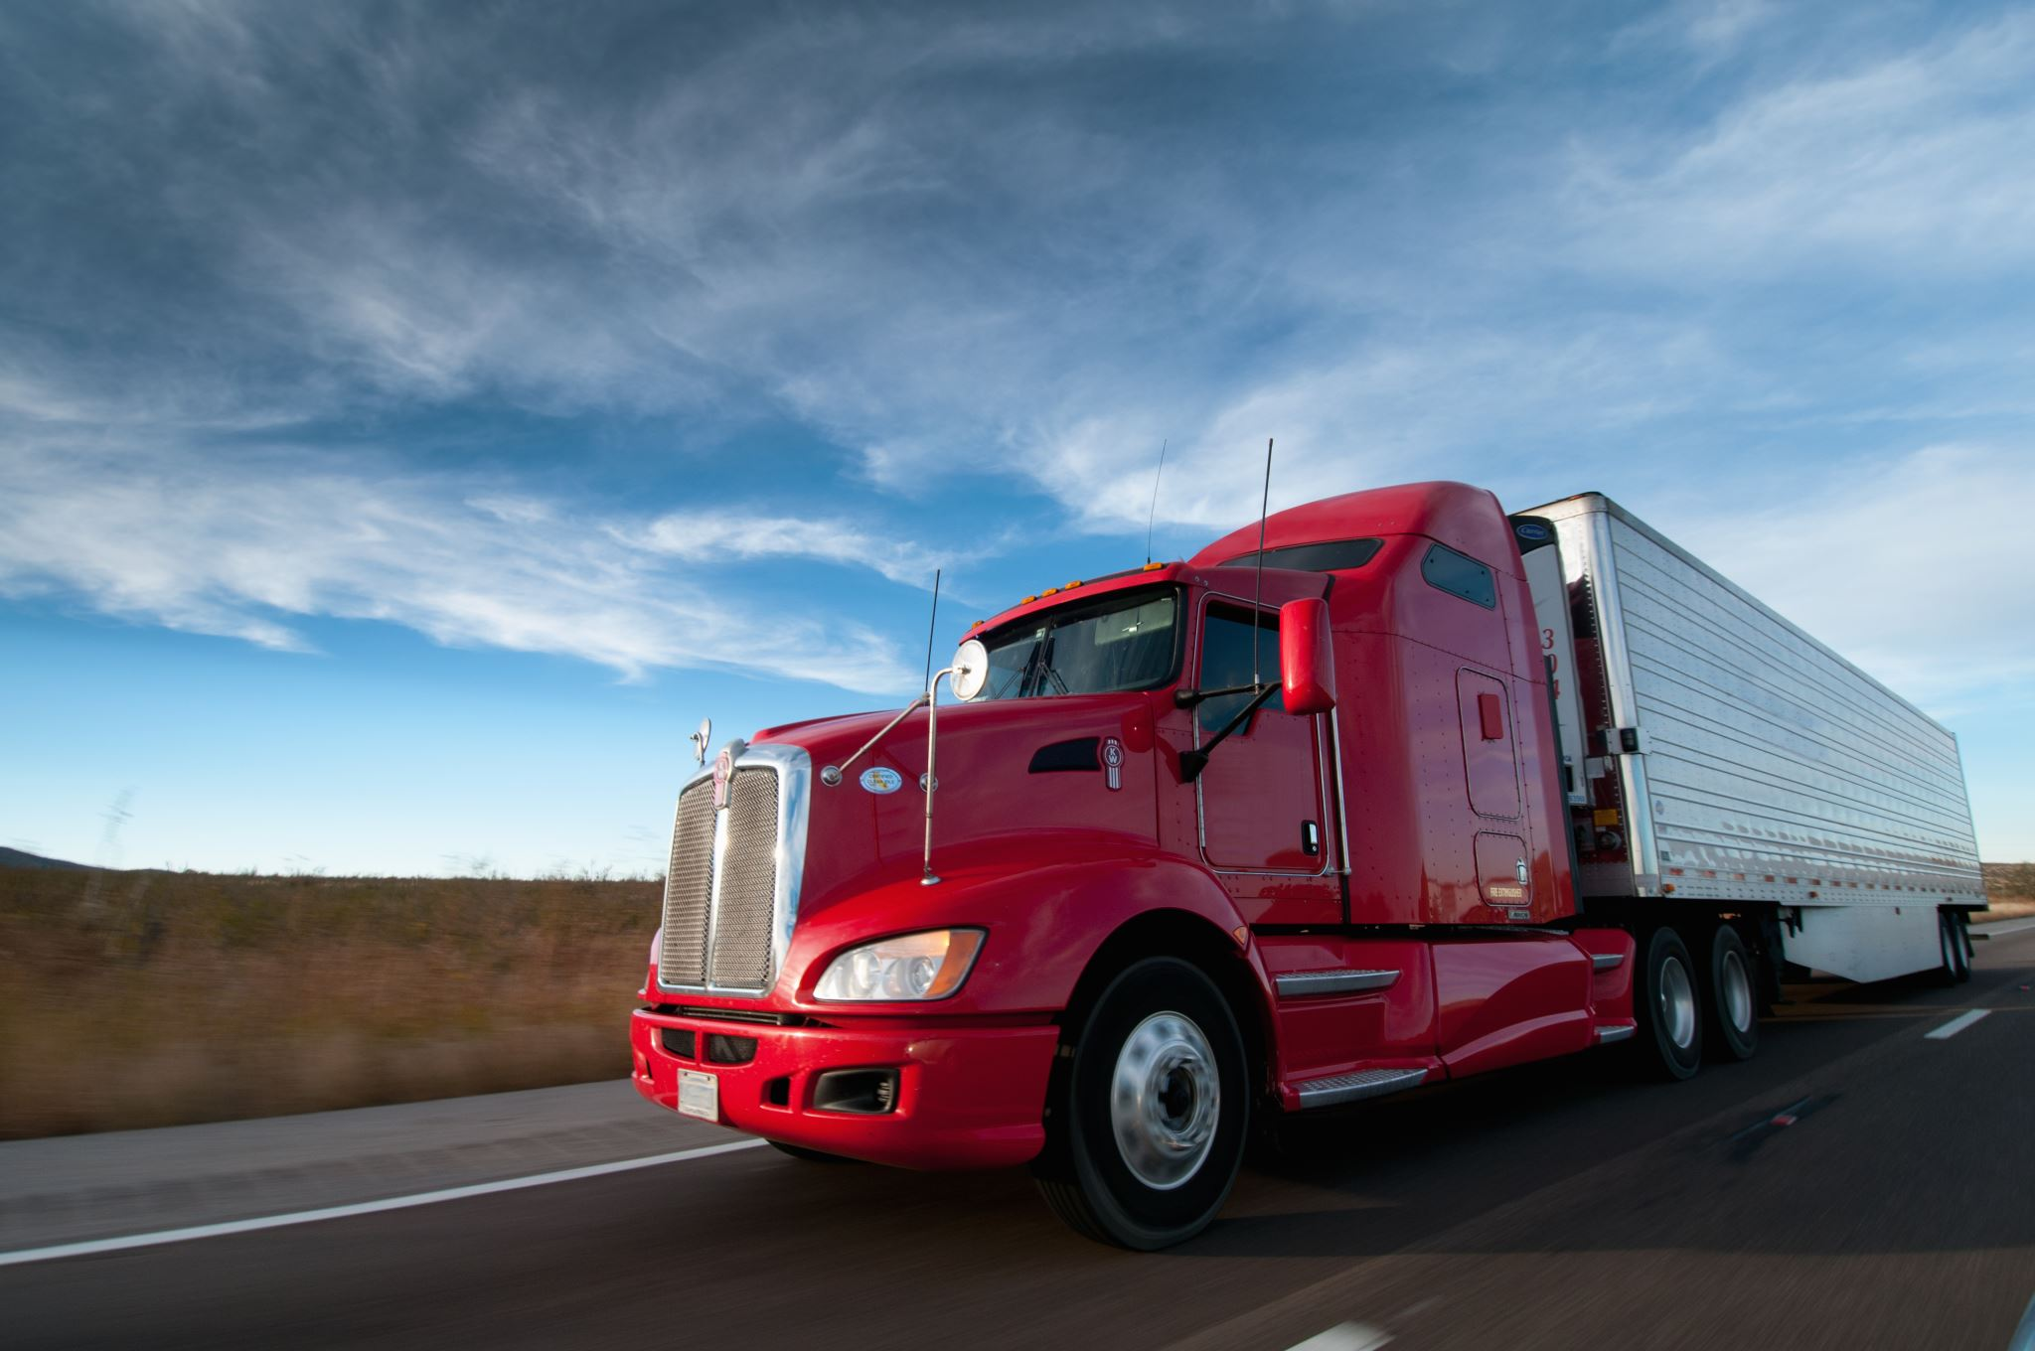
Problem Overview
Freight trucks often get stuck in traffic and face long wait times to pick up the cargo and deliver back to the destination.
This leads to:
Wasted time and fuel while Idling
Missed delivery schedules
Congestion that slows down operations for everyone
The Challenge:
We can't make changes to any infrastructure, so we need a smart, software-based solution.
The Goal:
Create a system that:
Uses real-time traffic data
Makes dynamic routing decisions
Helps trucks avoid congestion
Keeps deliveries on time and operations running smoothly

Slide 3
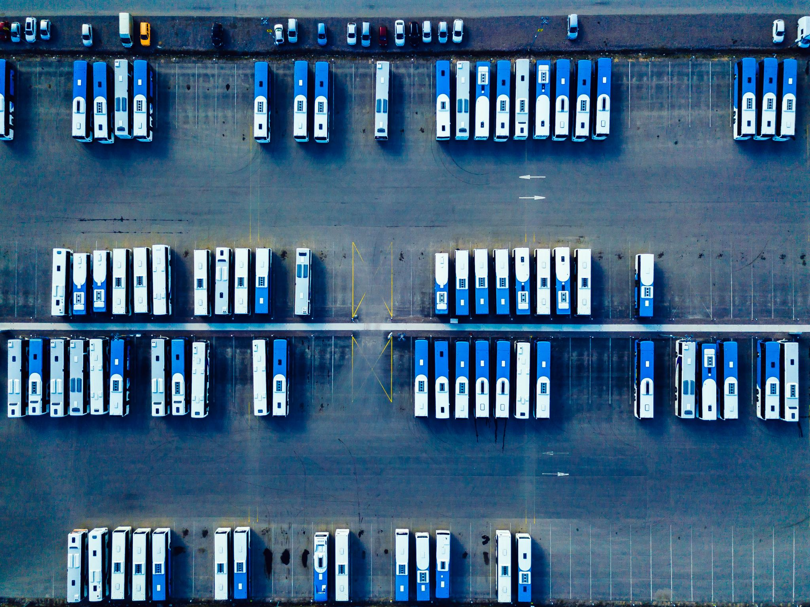
Problem Definition
Freight trucks face significant delays and inefficiencies while navigating through congested airport cargo zones, leading to increased idle time, missed delivery windows, and operational bottlenecks.
Without altering physical infrastructure, there is a critical need for a dynamic, software-driven solution that leverages real-time traffic data to optimize routing decisions.
This system must adapt on the fly to minimize delays and improve the overall flow of airport freight logistics.

Slide 4

Proposed Solution
Our Software-Driven Solution A dynamic routing system that adapts in real time to traffic, delivery schedules, and system data.
How It Works?
DALI Mock System → Simulates live traffic inputs
Airport System → Feeds operational data and flight status.
Backend System → Processes data and handles authentication
Mobile Interface → Displays assignment, optimal route for truck drivers.

Slide 5
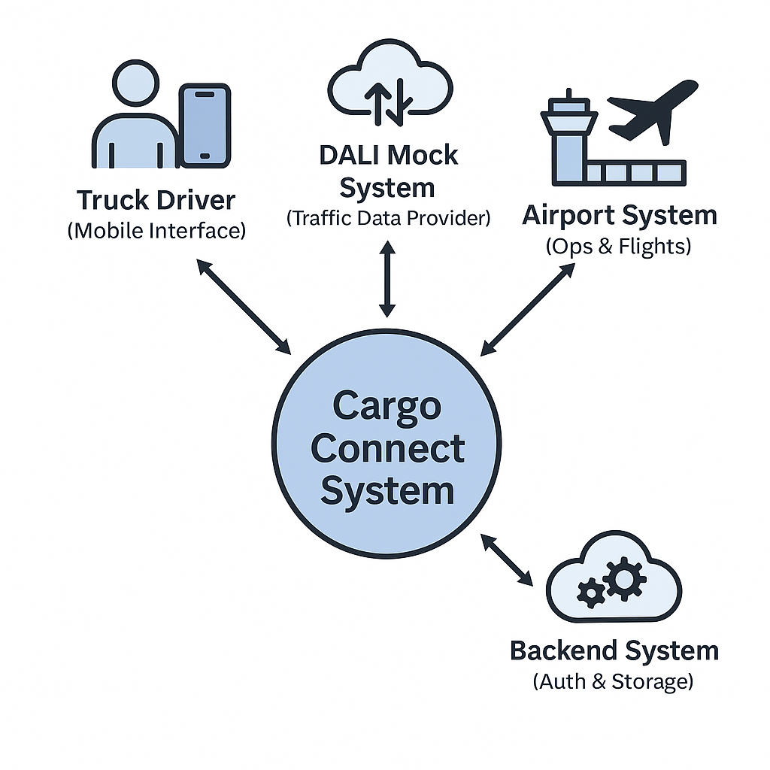
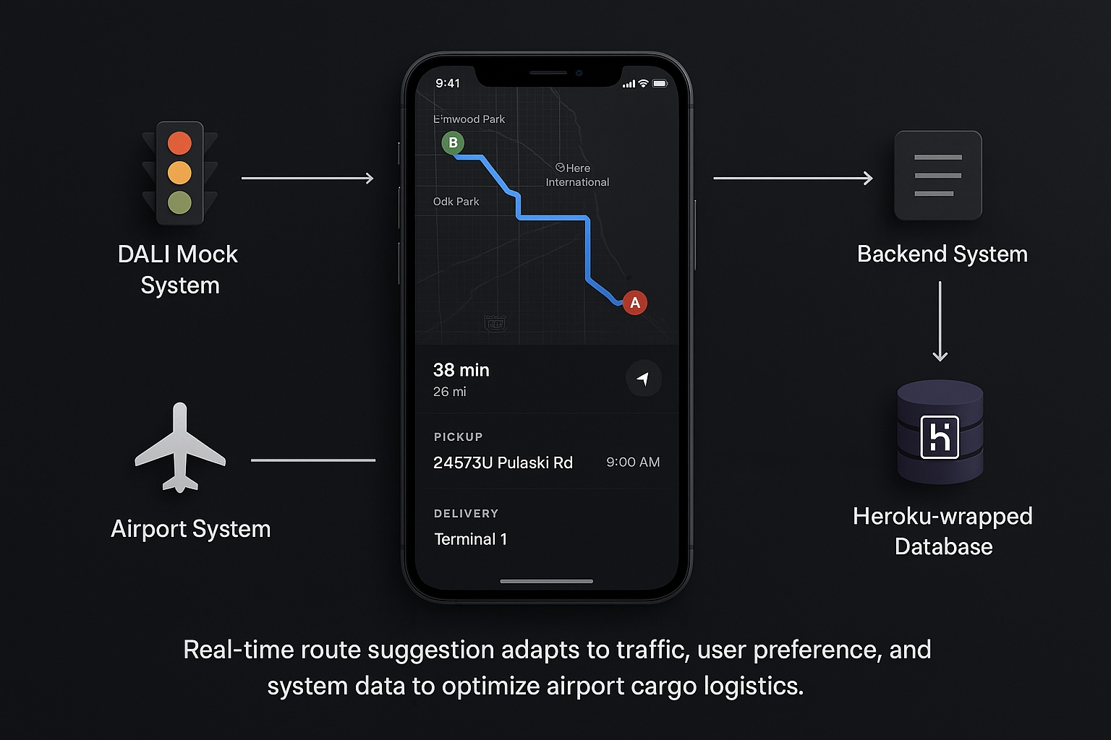
Context Diagram

Slide 6
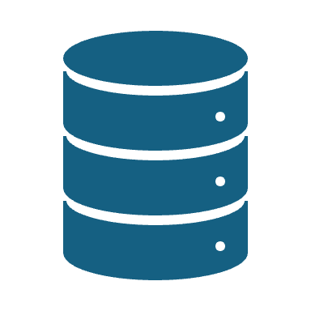
Technologies Needed
Mobile Application: Kotlin
Community Support
Highly used framework for the mobile app
Highly maintainable in the long-term
UI Component: Jetpack Compose
High reusability & compatible with Kotlin
Simplified state management
Real-time UI rendering
Backend: Flask for Restful API
Lightweight nature
Quick development of REST APIs
Easy integration with preexisting libraries

Slide 7
Technologies Needed
Database: PostgreSQL
Highly Scalable
Strong performance
Its powerful native management application across multiple platforms
DALI mock: Laravel
Its formidable routing capability
Data seeding feature & resource Controllers
Documentation and Community Support
Airport mock: Python
Consistency with the existing backend language
Ease in terms of writing executable scripts

Slide 8
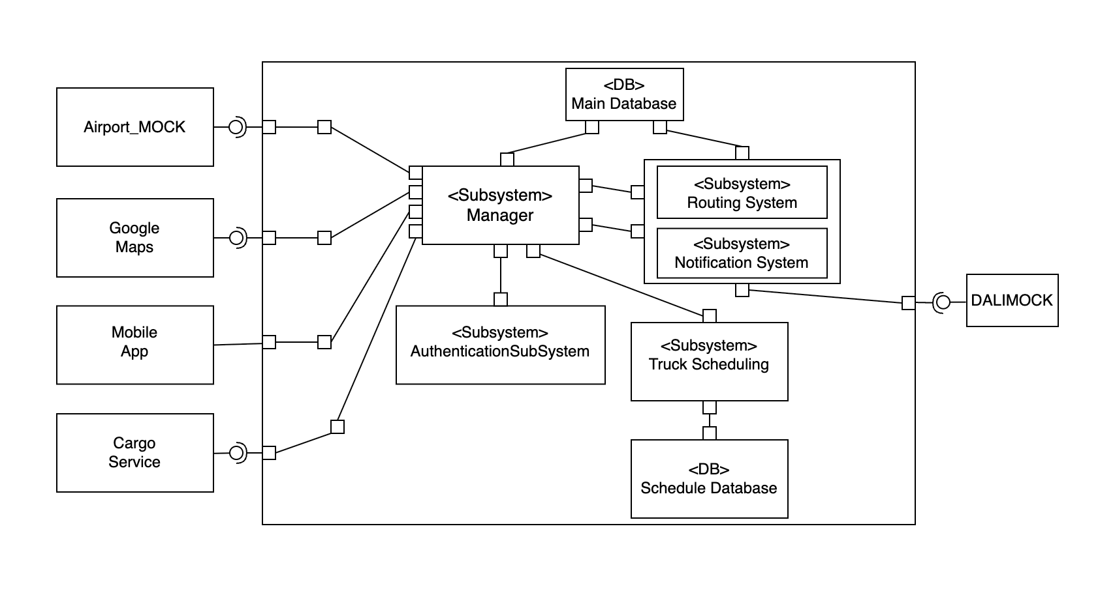
High level architecture

Slide 9

High Level Architecture
Main Components:
External Interfaces:
Airport System, Google Maps, Mobile App, Cargo Service, DALIMOCK
Core Subsystems:
Manager: Central controller managing all data flow
Authentication Sub system: Handles login and access control
Truck Scheduling: Assigns and tracks freight schedules
Routing System: Determines optimal routes
Notification System: Sends real-time updates to users/services
Databases:
Main Database
Schedule Database (for Truck Scheduling)

Slide 10
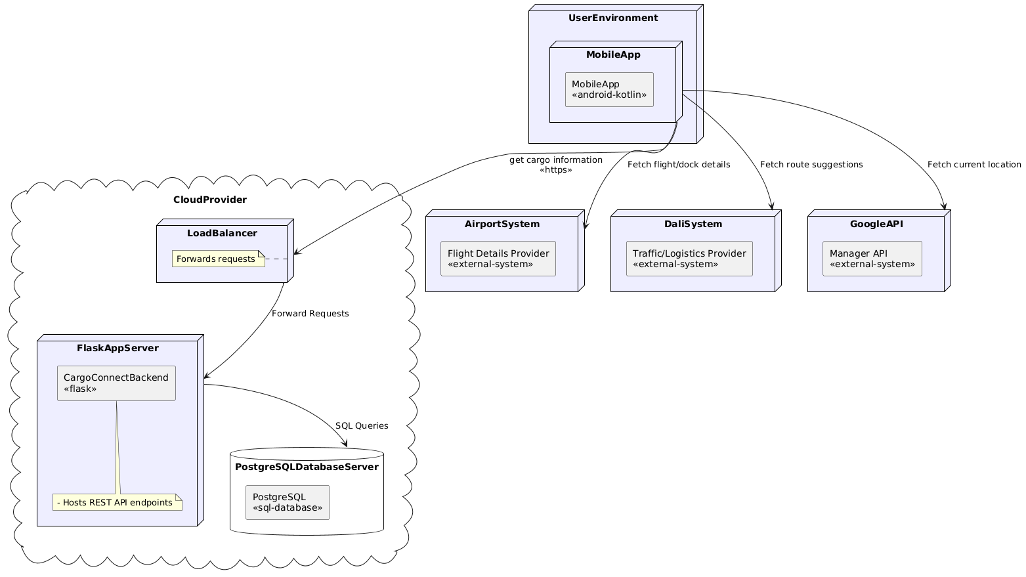
Deployment Diagram

Slide 11

Deployment diagram
Key Components:
User Device:
Android-based Mobile App fetches cargo, location, flight, and route data.
Cloud Infrastructure (Provider):
Flask App Server: Hosts REST API endpoints using Flask
PostgreSQL Database Server: Stores and retrieves scheduling, routing, and cargo data
External Systems (APIs):
Airport System: Supplies flight and docking info
DALI System: Provides traffic and logistics data
Google API: Supplies real-time maps and location service

Slide 12
Current Limitations
Testing & Validation Limitations
Reliance on Mock Systems:
Exclusively tested on mock systems: DALI and Airport.
Actual testing on DALI/Airport systems remains pending.
Simulated Execution:
Truck movement is simulated via Google Maps API.
Actual Vehicle testing with sensor data has not been validated.
Edge-Case Coverage:
Successfully Simulated: Happy, Accident, Parking, Pullover, Dock Assignment.
Missing: Real world scenarios
Unexpected environmental factor
System Latency
Critical logistics workflows
Cargo loading/unloading timings

Slide 13
Current Limitations
Non-Functional Limitations
Scalability & Performance:
Only tested on Small Database.
Large Scale Database: Latency and Responsiveness remains unvalidated.
Deployment & Platform Limitations
Android-Centric Implementation:
Mobile Application codebase is Kotlin based.
iOS version Mobile Application has not been implemented.

Slide 14
Lessons Learned
End-to-End Project Lifecycle Ownership
Defining clear problem statements upfront to align architecture, scope, and stakeholder expectations.
Architecture is more important than the code.
Modular & Scalable System Design
Decoupling components enabled plug-and-play mock systems
Third-Party Integration & Parallelism
Designing for asynchronous workflows
DALI and Airport Mock.
Collaboration & Adaptability
Iterative feedback from our professor & mates during semester-long demos significantly improved our system.

Slide 15

Thank You

